Slide 1








Chongqing University of Technology
ATAI
Advanced Technique of Artificial Intelligence
Chongqing University of Technology
Qi Zhang Zhen Lei Zhaoxiang Zhang Stan Z. Li
NLPR, Institute of Automation, Chinese Academy of Sciences, Beijing, China
School of Artificial Intelligence, University of Chinese Academy of Sciences, Beijing, China Center for AI Research and Innovation, Westlake University, Hangzhou, China.
Context-Aware Attention Network for Image-Text Retrieval
——CVPR 2020
2020.12.28 • ChongQing
Reported by Jia Wang

Slide 2

Chongqing University of Technology
ATAI
Advanced Technique of Artificial Intelligence
Chongqing University of Technology
1.Introduction
2.Method
3.Experiments
4.Conclusion

Slide 3
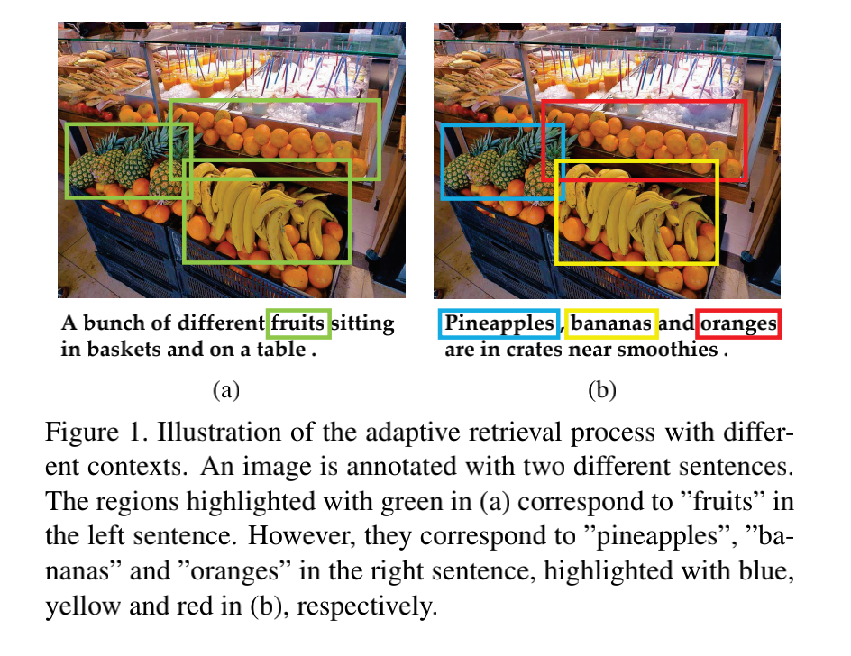
Introduction

Slide 4
Introduction
most previous attention-based methods ignore the fact that a word or region might have different semantics in different global contexts. Specifically, the global context refers to both interaction and alignments between two modalities (inter-modal context) and semantic summaries and correlations in a single modality(intra-modal context).
We propose a unified Context-Aware Attention Network to adaptively select informative fragments based on the given context from a global perspective
We evaluate our proposed model on two benchmark datasets Flickr30K and MS-COCO and it achieves fairly competitive results
Notes:
Aspect：picture quality
Polarity：positive
Aspect：battery life
Polarity：negative

Slide 5
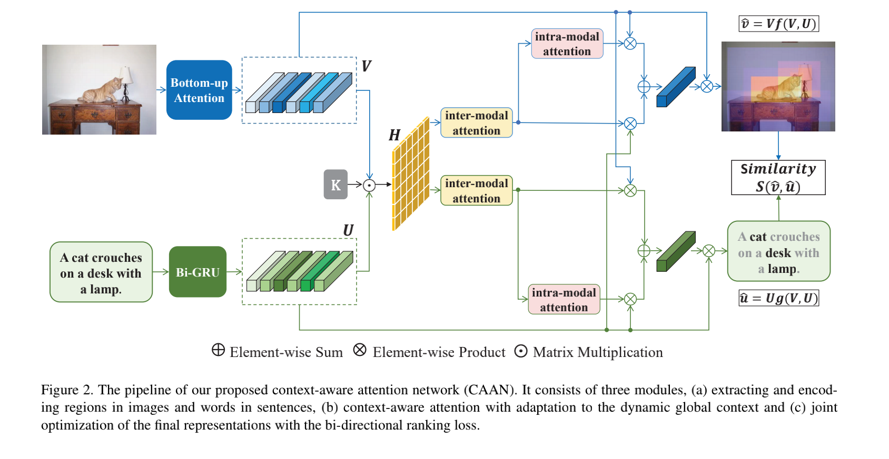
Method

Slide 6
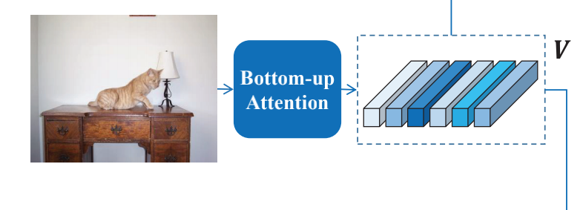
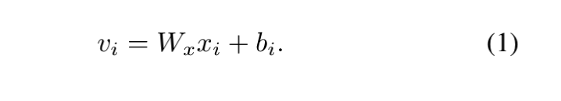

Method
we detect objects and other salient regions in each image utilizing a Faster R-CNN model in conjunction with ResNet-101 in two stages, which is pretrained on Visual Genome.
在第一阶段，模型使用贪婪的非最大值抑制和IoU阈值来选择排名靠前的box方案。 在第二阶段，在平均合并卷积层之后提取这些边界box的特征。

Slide 7
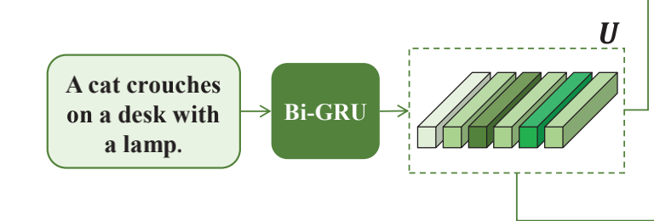
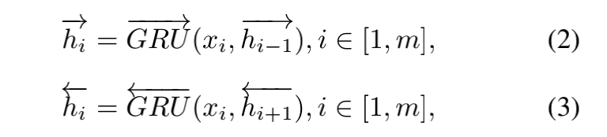

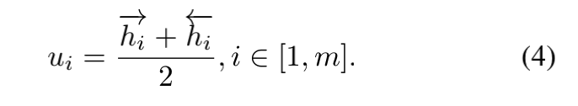



Method
（one hot）

Slide 8
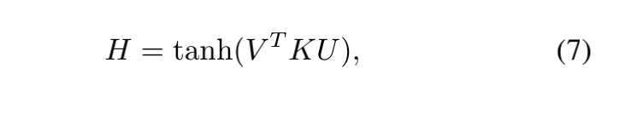
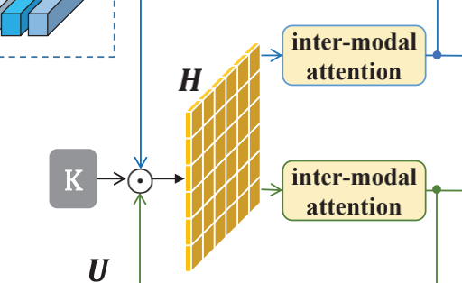
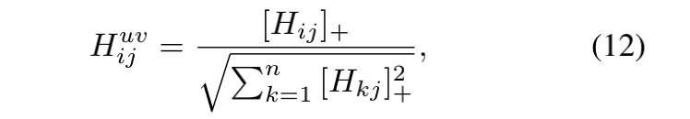
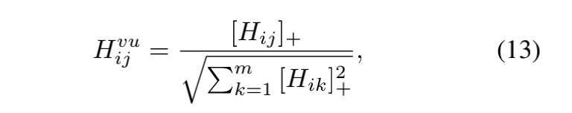



Method
Each element in the word-to-region attention matrix represents the relative pair-wise correspondences of two local fragments region vi and word uj.

Slide 9
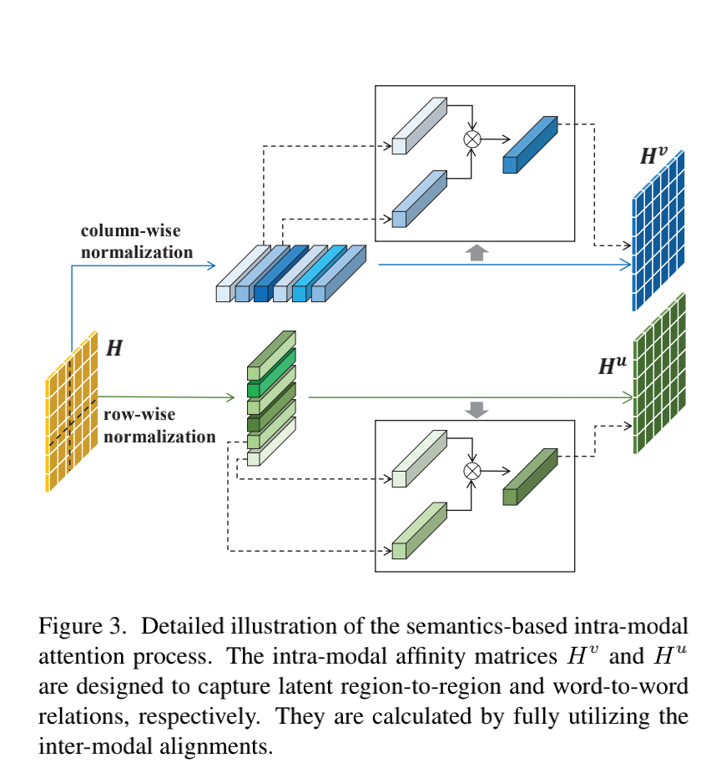
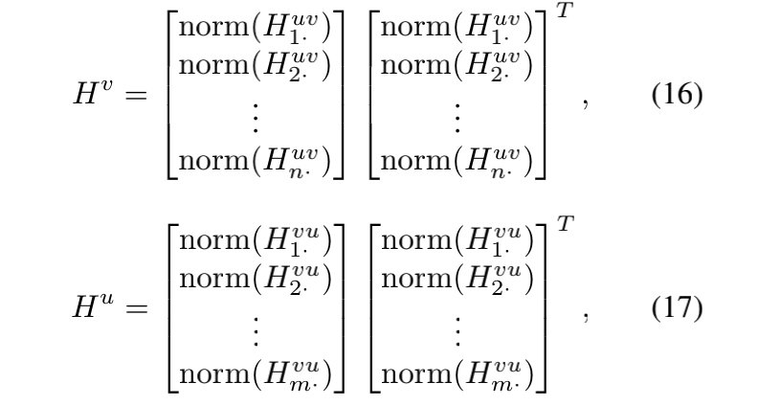
Method

Slide 10
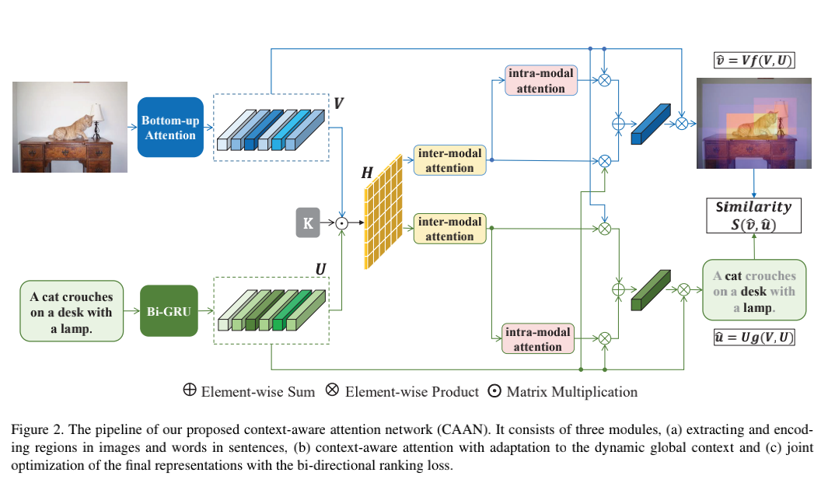
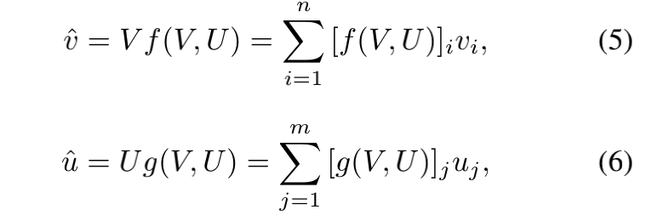

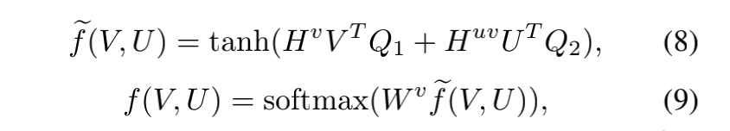
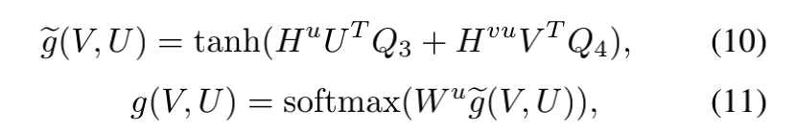
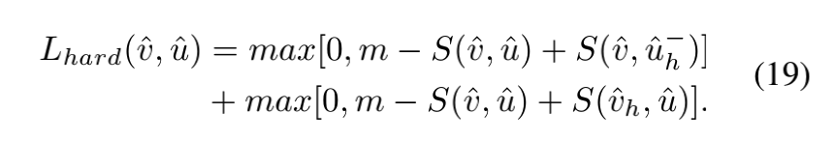
Method

Slide 11
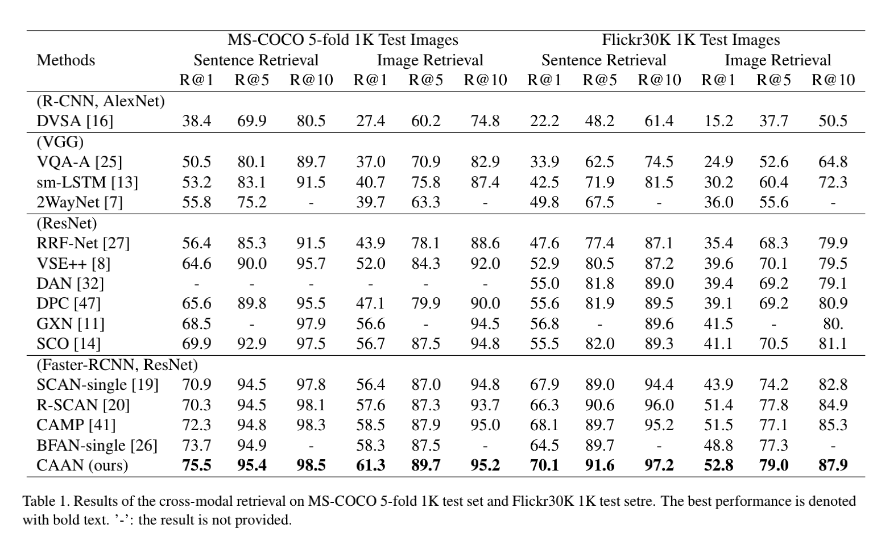
Experiments

Slide 12
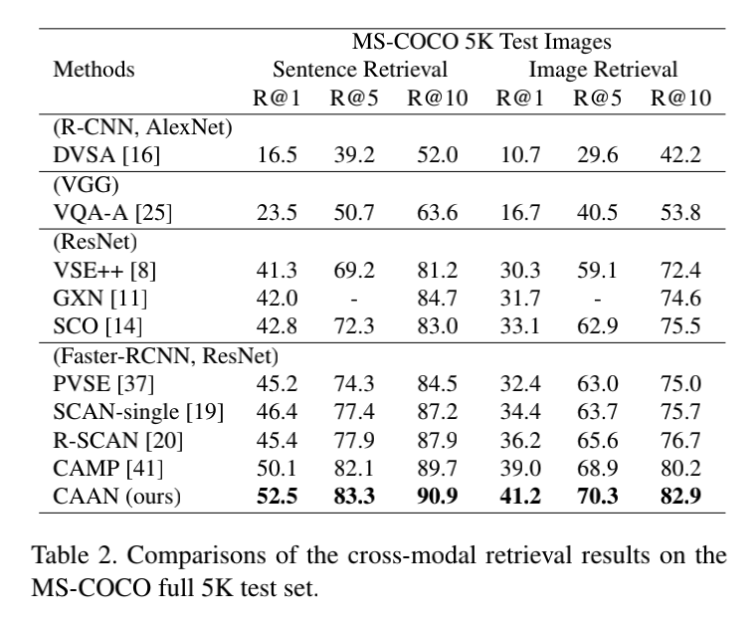
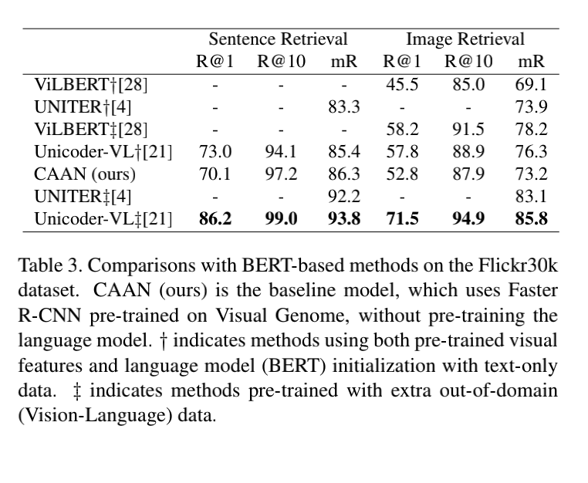
Experiments

Slide 13
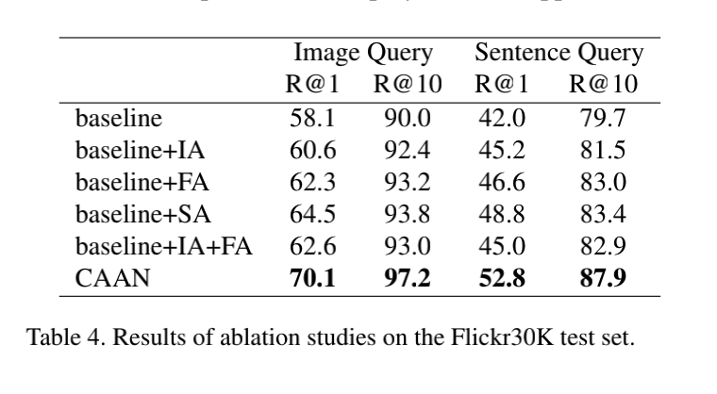
Experiments

Slide 14
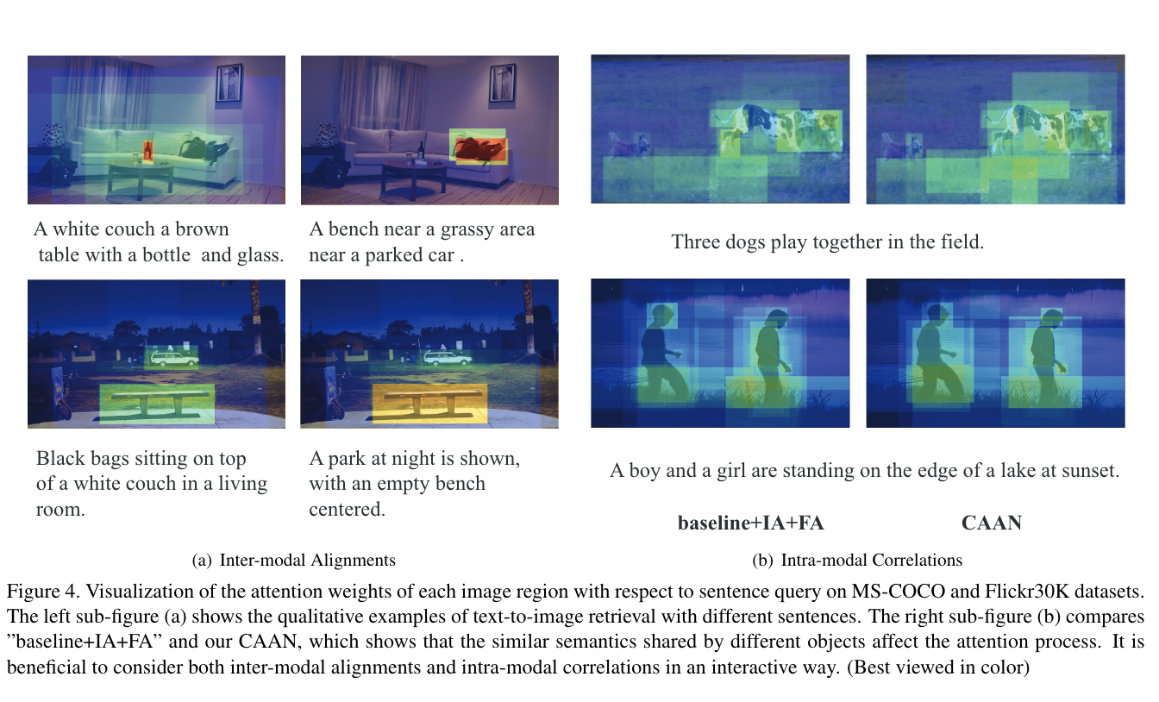
Experiments

Slide 15
Conclusion
In this paper, we propose a unified Context-Aware Attention Network (CAAN) to formulate the image-text retrieval as an attention process to selectively focus on the most informative local fragments. By incorporating intramodal and inter-modal attention, our model aggregates the context information of alignments between word-region pairs (inter-modal context) and semantic correlations between fragments in a single modality (intra-modal context). Furthermore, we perform the semantic-based attention to model intra-modal correlations, which is the
interpretable second-order attention of region-word alignments. The model demonstrates its effectiveness by achieving fairly competitive results on the Flickr30K and MSCOCO datasets.

Slide 16
Thank you!

